Slide 1
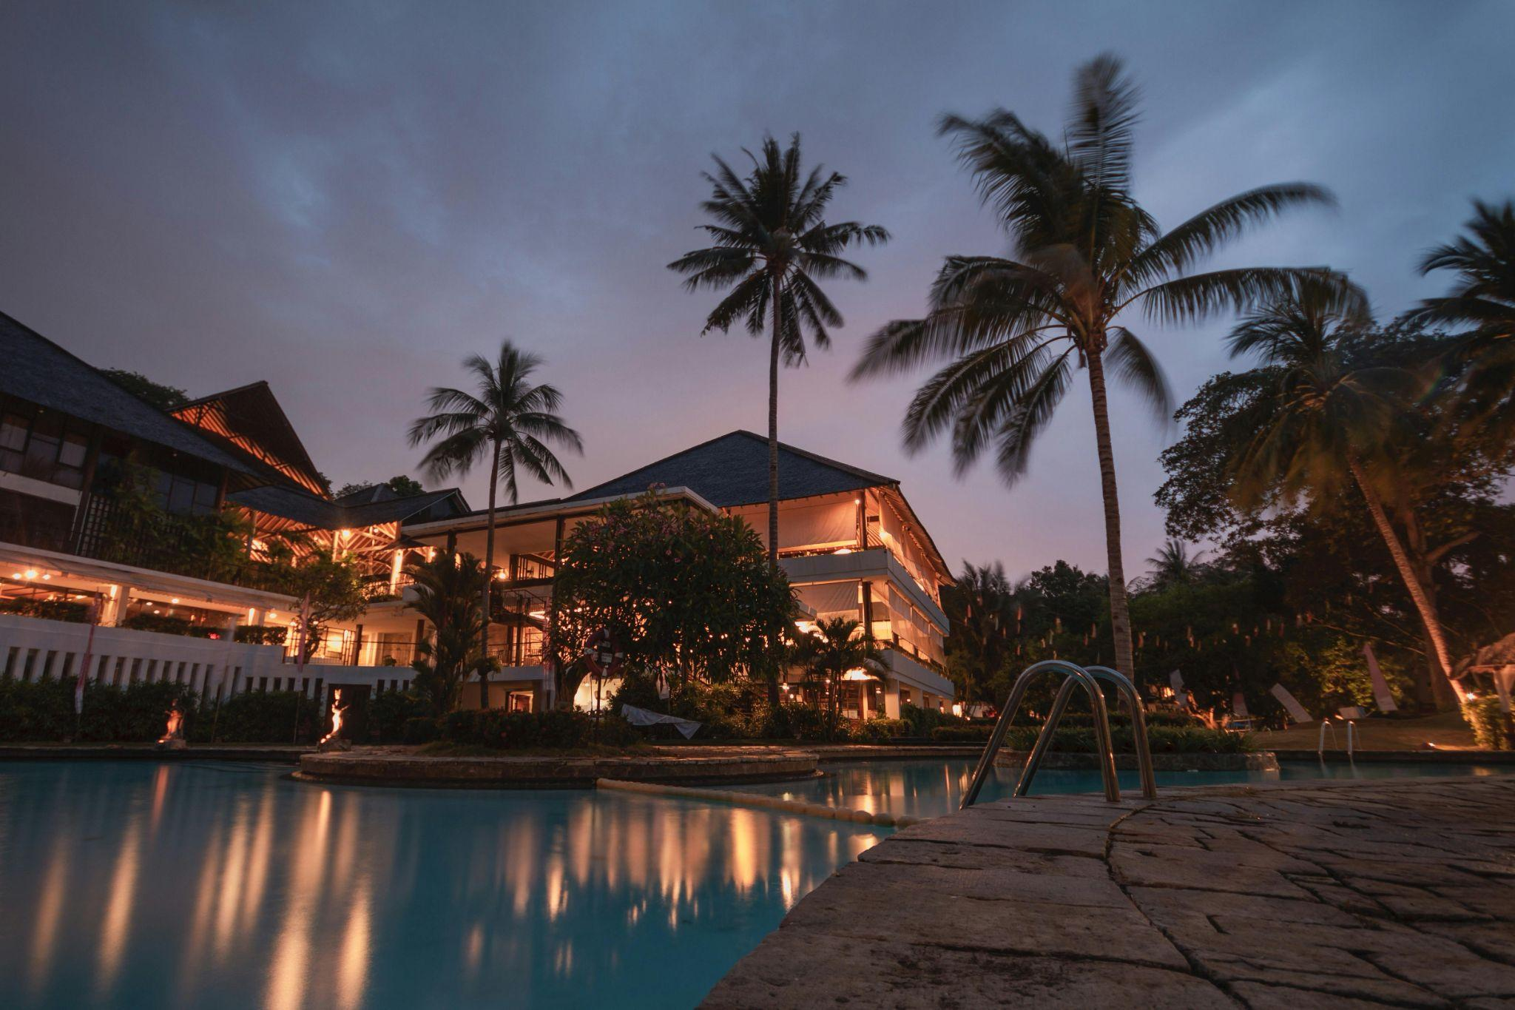
Cozy Haven Stay
A dream place to stay…..

Slide 2
Index
Project Overview
Technologies Used
Frontend
Backend
Unit Testing
App Demo
Conclusion

Slide 3
Project Overview
Technologies Used
Frontend
Backend
Unit Testing
Conclusion
The Cozy Haven Stay Hotel Booking System is a comprehensive web application that allows users to search, book, and manage hotel reservations online. It caters to both guests and hotel administrators, providing a user-friendly experience for travelers and efficient management tools for hotel staff.

Slide 4
Frontend: React.js,HTML5,CSS3,Bootstrap
Backend: Java Script, Node JS,Express JS
Database: MySql
Authentication: JSON Web Tokens (JWT) for secure user authentication.
Project Overview
Technologies Used
Frontend
Backend
Unit Testing
Conclusion

Slide 5
Register and Login Pages for user, Hotel Owner and Admin
Separate Dashboards for User, Hotel Owner and Admin to performs various operations
Update, Login and Register components are implemented with required validations
Structured service files to communicate with backend API’s
Project Overview
Technologies Used
Frontend
Backend
Unit Testing
App Demo
Conclusion

Slide 6
Used ORM(sequelize/mysql2) with database.
perform backend data validation(express-validator).
Used Postman tool to invoke APIs.
Implement security to allow/deny Create, Update, Delete operations.
Used express router for API’s
Message input/output format should be in JSON (Read the values from the property/input files, wherever applicable).
error message or exception will be logged and should be user- readable
Implement JWT for Security and bcrypt for password hashing.
Implement Logging.
used cookie-parser to store and get values from cookies
Project Overview
Technologies Used
Frontend
Backend
Unit Testing
App Demo
Conclusion

Slide 7
Project Overview
Technologies Used
Frontend
Backend
Unit Testing
App Demo
Conclusion
Implemented Unit Test Project for testing the API.
Used mocha and chai(chaiHttp and should-assertion) .
Implemented separate test files for Admin, User and Hotel owner.

Slide 8
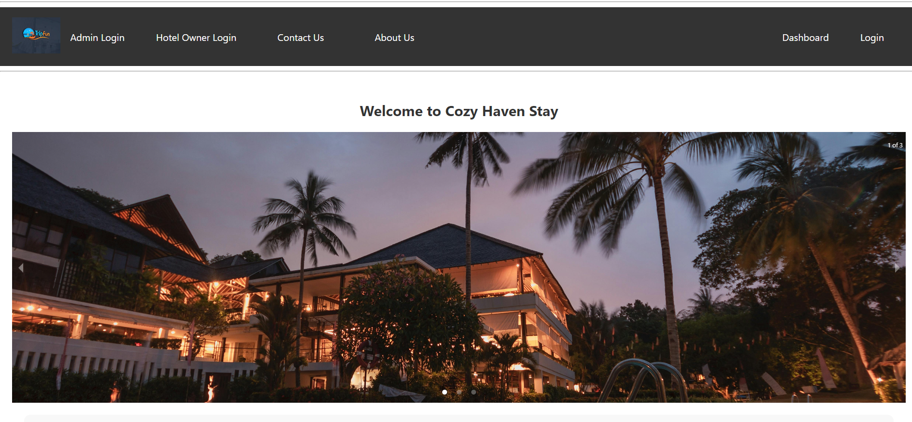
App Demo
Project Overview
Technologies Used
Frontend
Backend
Unit Testing
App Demo
Conclusion
http://localhost:3001/

Slide 9
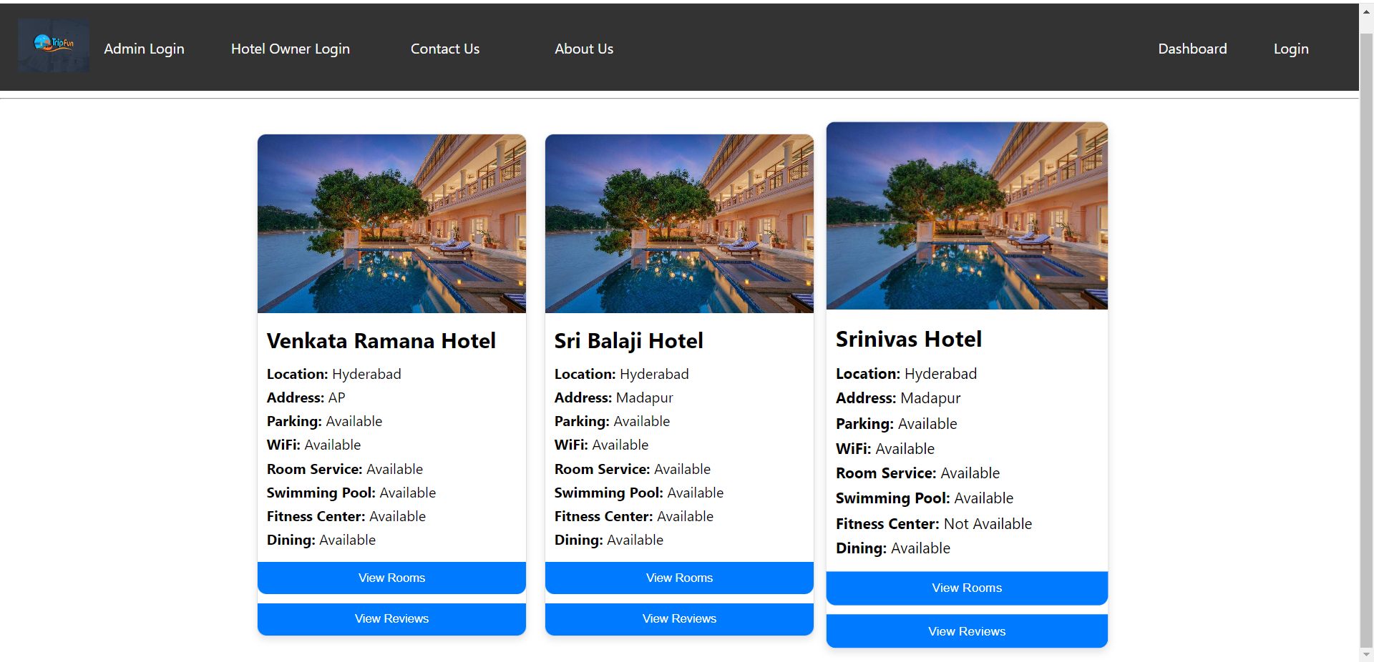
Search Hotels Page
Project Overview
Technologies Used
Frontend
Backend
Unit Testing
App Demo
Conclusion

Slide 10
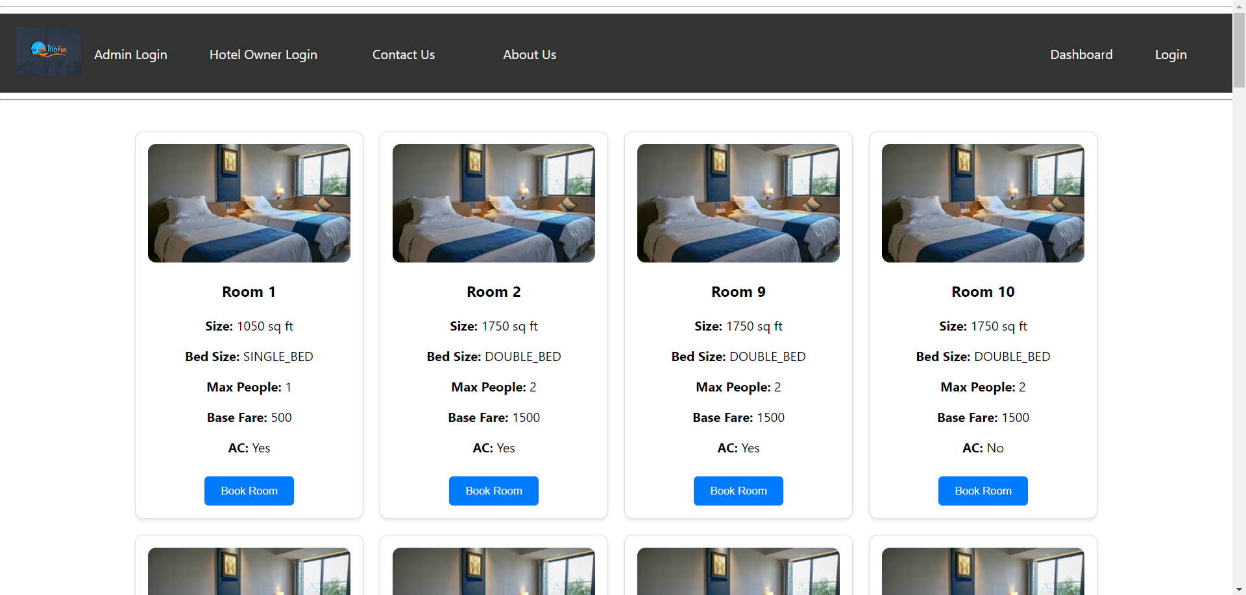
Rooms Page
Project Overview
Technologies Used
Frontend
Backend
Unit Testing
App Demo
Conclusion

Slide 11
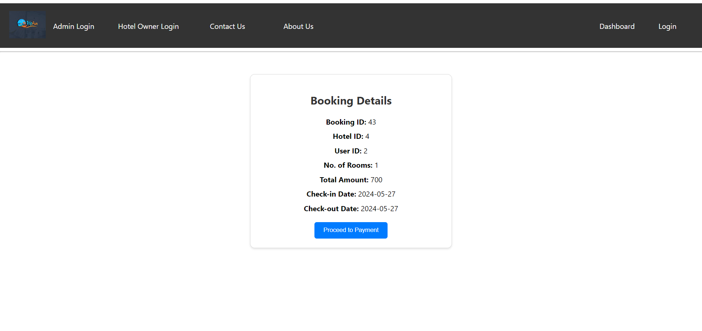
Booking Page
Project Overview
Technologies Used
Frontend
Backend
Unit Testing
App Demo
Conclusion

Slide 12
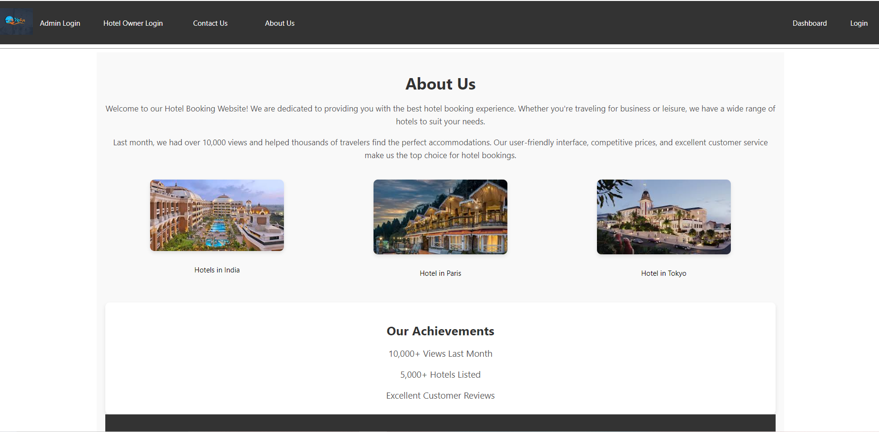
About Us Page
Project Overview
Technologies Used
Frontend
Backend
Unit Testing
App Demo
Conclusion

Slide 13
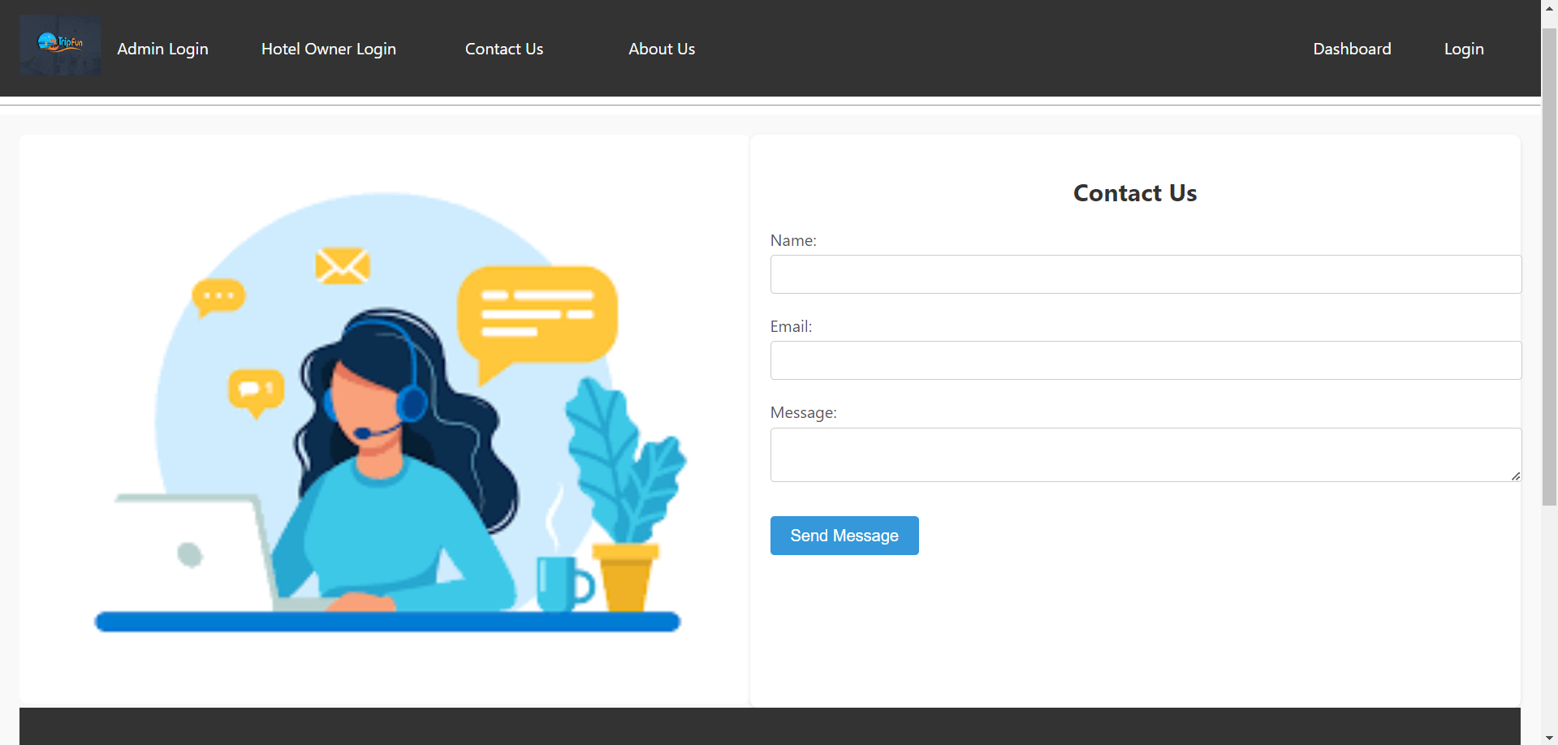
Contact Us Page
Project Overview
Technologies Used
Frontend
Backend
Unit Testing
App Demo
Conclusion

Slide 14
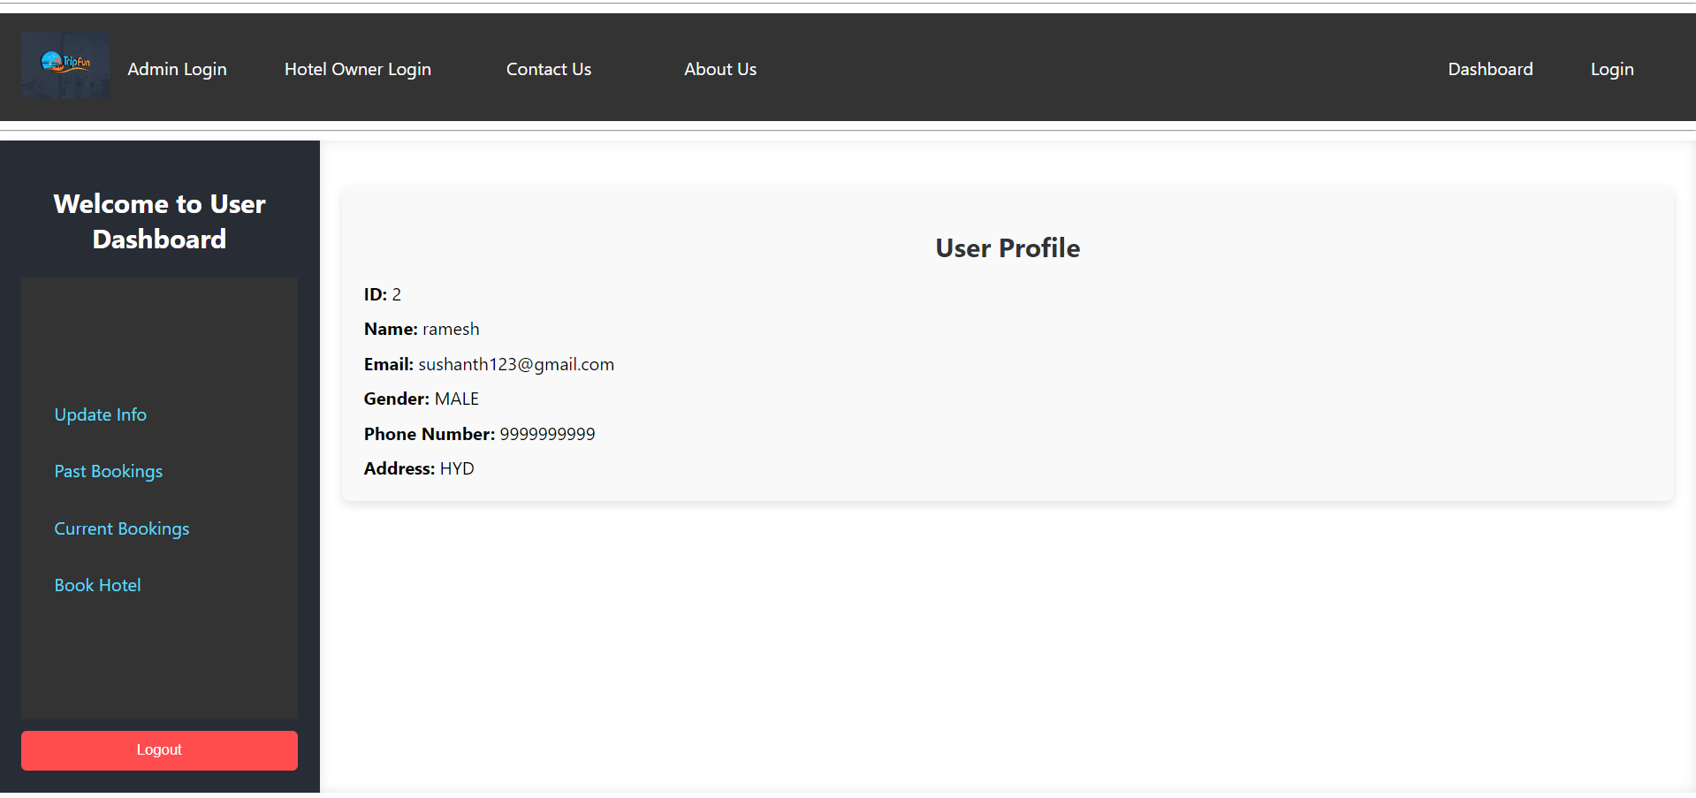
User Dashboard
Project Overview
Technologies Used
Frontend
Backend
Unit Testing
App Demo
Conclusion

Slide 15
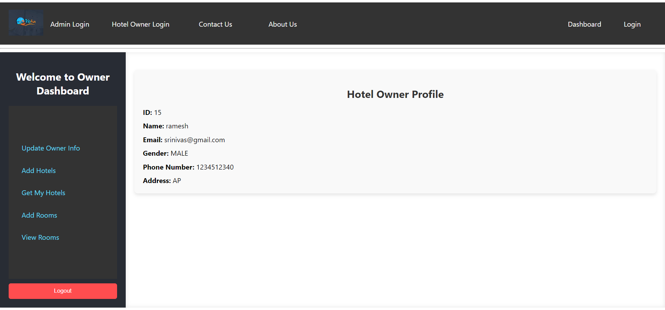
Hotel Owner Dashboard
Project Overview
Technologies Used
Frontend
Backend
Unit Testing
App Demo
Conclusion

Slide 16
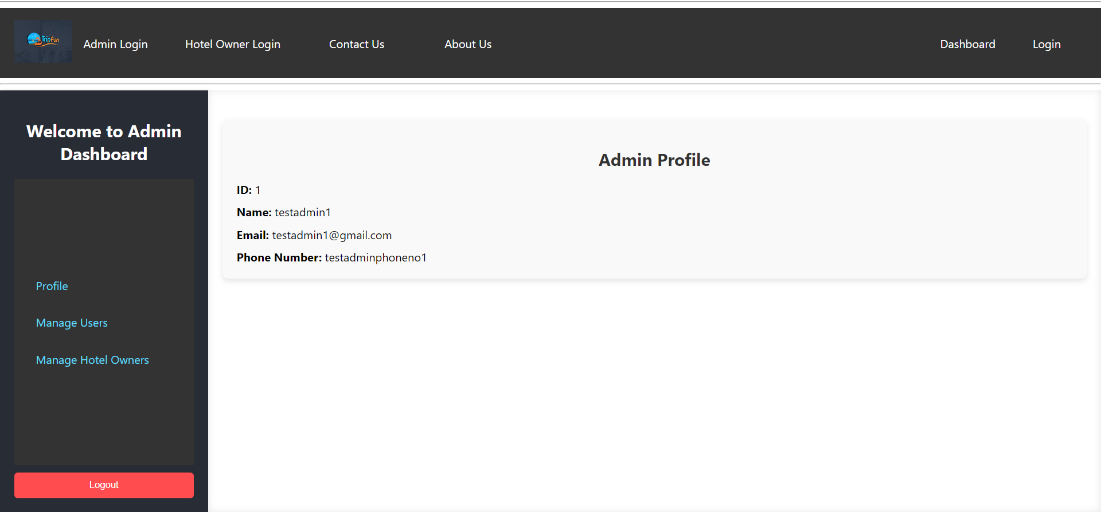
Admin Dashboard
Project Overview
Technologies Used
Frontend
Backend
Unit Testing
App Demo
Conclusion

Slide 17
Project Overview
Technologies Used
Frontend
Backend
Unit Testing
App Demo
Conclusion
This hotel booking website is a a user-friendly platform for booking and managing hotel stays, that caters to the needs of both travelers and hotel administrators, offering a seamless and efficient experience for booking and managing hotel stays.

Slide 18
Thank You..

